Slide 1
J2EE
SESSION TRACKING IN J2EE

Slide 2
Session Objectives
How to track the records of multiple user
Without any conflict between the users.
selecting the suitable and relevant mechanism to track the session

Slide 3
Agenda
Hidden fields
Session tracking
Cookies
Url Rewriting

Slide 4
Session Tracking
Session:
A session is a conversation between the server and a client. A conversation consists series of continuous request and response
Why should a session be maintained?
When there is a series of continuous request and response from a same client to a server, the server cannot identify from which client it is getting requests. As the HTTP is a stateless protocol it will not
maintain the conversational state ,we are in need of tracking the user for multiple request in one session . The ways we are using to track the sessions are
Hidden fields
Session tracking
Cookies
Url Rewriting

Slide 5
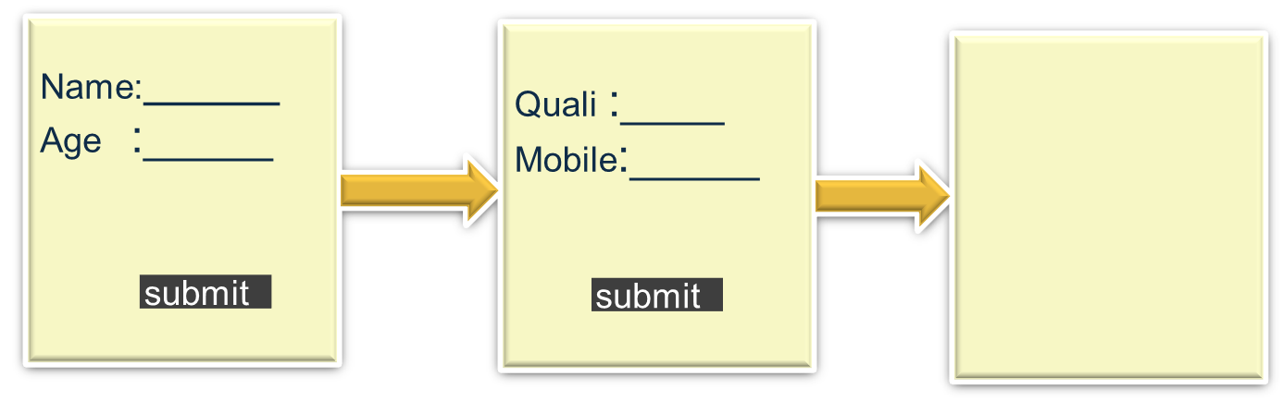
Hidden Fields
Name :xxxx
Age :28
Quali :BE
Moblie:88999
Data retrieved from first page will be carried to the third page put it is not visible in the second page

Slide 6
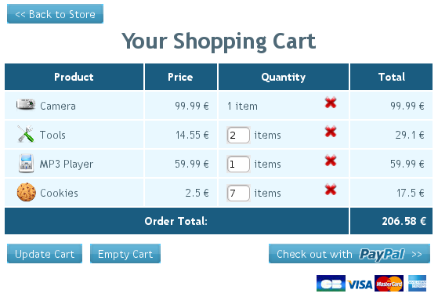
Session Tracking
HTTP is a stateless protocol. Each request and response
message connection is independent of all others. Therefore,
the web container must create a mechanism to store session
information for a particular user.

Slide 7






Session Tracking
Web Container Sessions:
The web container create and maintain an individual session object for each user:
browser
Webserver
Id 123
browser
Web Container
Id 346
browser
Id 278

Slide 8
Session Api
javax.servlet.http
javax.servlet.http
HttpServletRequest
HttpSession
getSession (create :boolean)
getSession()
getID() :String
isNew() :boolean
getAttribute(name):Object
setAttribute(name , value)
removeAttribute(name)
getCreationTime() :long
getLastAccessedTime() :long
getMaxInactiveInterval() :int
setMaxInactiveInterval(int))
Session

Slide 9
Syntax for session
Setting the value in session Object:
HttpSession session=request.getSession();
session.setAttribute("name",name);
session.setAttribute("loc",loc);
Getting the value in session Object:
HttpSession session=request.getSession();
session.getAttribute("name");
session.getAttribute("loc”);

Slide 10
Cookies
• Cookies are sent in a response from the web server.
• Cookies are stored on the client’s computer.
• Cookies are stored in a partition assigned to the web
server’s domain name. Cookies can be further
partitioned by a path within the domain.
• All cookies for that domain (and path) are sent in every
request to that web server.
• Cookies have a lifespan and are flushed by the client
browser at the end of that lifespan

Slide 11
Cookies Api
javax.servlet.http
HttpServletRequest
Cookies
properties
name : String
value : String
comment : String
domain : String
path :String
maxAge : int
HttpServletResponse
Cookies

Slide 12
Syntax for session Tracking
The code to store a cookie in the response:
String name = request.getParameter("firstName");
Cookie c = new Cookie("yourname", name);
response.addCookie(c);
The code to retrieve a cookie from the request:
Cookie[] allCookies = request.getCookies();
for ( int i=0; i < allCookies.length; i++ ) {
if ( allCookies[i].getName().equals(“yourname”) ) {
name = allCookies[i].getValue();
}
}

Slide 13
Cookies
Performing Session Management Using Cookies:
• The Cookie mechanism is the default session
management strategy.
• There is nothing special that you code in your servlets
to use this session strategy.
• Unfortunately, some users turn off cookies on their
Browsers
Then we suppose to turn to URL ReWriting

Slide 14
UrlRewriting
Using URL-Rewriting for Session Management :
• URL-rewriting is used when Cookies cannot be used.
• The server appends extra data on the end of each URL.
• The server associates that identifier with data it has
stored about that session.
• With this URL:
http://host/path/file;jsessionid=123 session
information is jsessionid=123.

Slide 15
UrlRewriting
Every HTML page that participates in a session (using URL-rewriting)
must include the session ID in all URLs in those pages. This requires dynamic generation.
Use the encodeURL method on the response object to
guarantee that the URLs include the session ID
information.
Syntax
out.println(“<form action=‘ “+ response.encodeURL(“sample.do”)
+ “‘ method=’POST’>”);

Slide 16


Slide 17
Quiz
What are the various ways of session tracking in a servlet?
In which are the objects getAttribute() and setAttribute() are available
Session can be turned off after particular seconds of Idle stage of the user through xml file ?
Which is the default Session Tracking mechanism
Hidden Fields is the Session Tracking mechanism which is mostly used as default mechanism
Cookies can be manually turned off in the client system
Statement: Cookies are getting the session id from its own system.-Explain

Slide 18
Summary
• Use cases that must share data across multiple HTTP
requests require session management.
• The web container supplies a session management
mechanism because HTTP is a stateless protocol.
• A web application can store and retrieve
session-scoped data in the HttpSession object which
is retrieved from the request object.
• The default session management mechanism uses
HTTP cookies.
• Web containers must also support URL-rewriting for
session management when the client has cookies
turned off.

Slide 19
Thank you

